Slide 1

Anomaly Detection Challenge - 4
Spam Detection
“The Outliers” presents
Nithish Raghunandanan
Vishal Bhalla
Picture courtesy Volusion

Slide 2
Agenda
Introduction
System Pipeline
Data Preprocessing & Analysis
Feature Engineering
Static Rules
Models
Kaggle Results
Conclusion
Key Takeaways
The Outliers - Vishal Bhalla & Nithish Raghunandanan

Slide 3
Introduction
Aim: Classify mail into Spam (0) or Ham (1).
Problem Type: Binary Classification
Samples:
Dataset is based on the CSDMC2010 SPAM corpus.
  Training Set: 2500
  Test Set: 1827
Features: Emails in RFC822 format.
Classification
  There are 2 decision classes: 0(Spam) and 1(Ham).
The Outliers - Vishal Bhalla & Nithish Raghunandanan

Slide 4
System Pipeline
Data Visualization
Feature Selection
Evaluation of Models
Data Visualization
  Tabulate & analyse the structure of the data.
Feature Selection
  Encoding selected parts of the data as features.
Evaluation of Models
  Classification accuracy using K Fold Stratified Cross Validation.
The Outliers - Vishal Bhalla & Nithish Raghunandanan

Slide 5
Data Analysis
Email Fields
  Subject - Length, Content & Presence of some characteristic Spam words in the Email Subject
  Body - Length, Content of Email Body
  PGP Signatures - Presence/Absence of PGP signatures in the Email Body
  SpamAssassin Classification - Spam mails classified as [spam] in Email subject
  Date - Date of the Email
  Sender - Presence of Sender field in the Email header
The Outliers - Vishal Bhalla & Nithish Raghunandanan

Slide 6
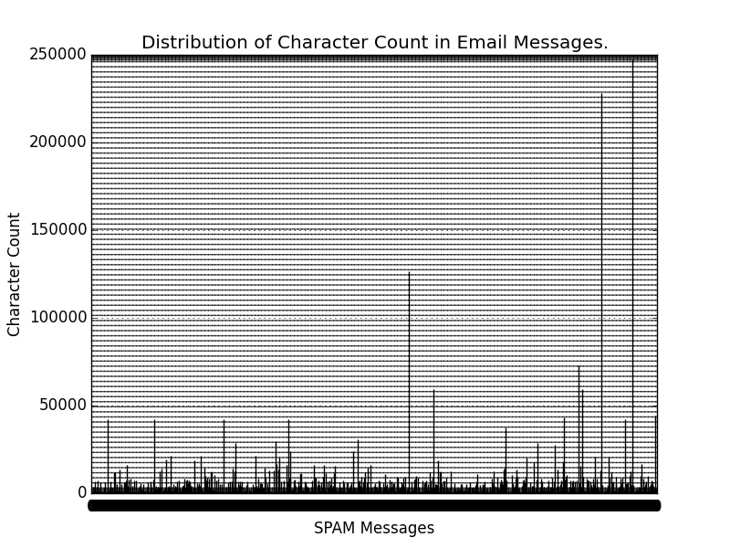
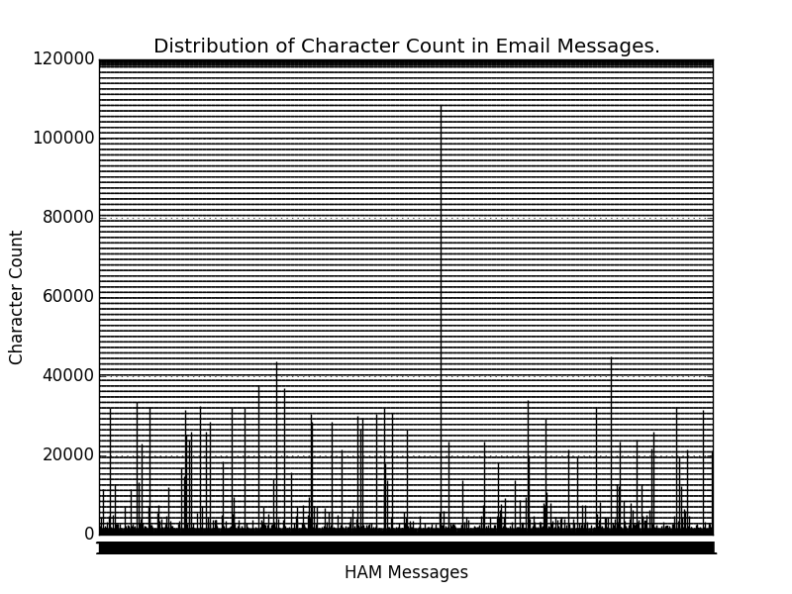
Distribution of Character counts in Email Message Body
Spam Detection
The Outliers - Vishal Bhalla & Nithish Raghunandanan

Slide 7
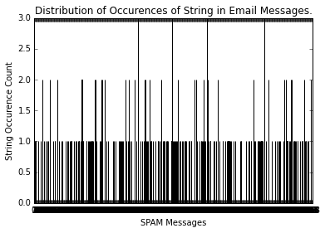
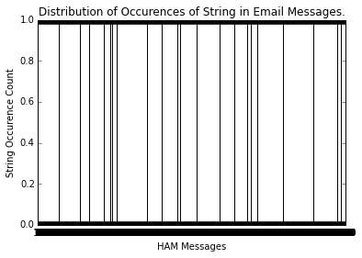
Distribution of Capital letter words in Email Message Body
Spam Detection
The Outliers - Vishal Bhalla & Nithish Raghunandanan

Slide 8
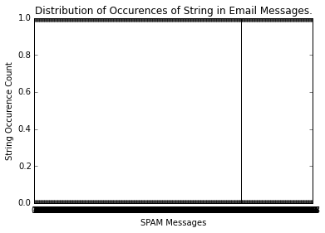
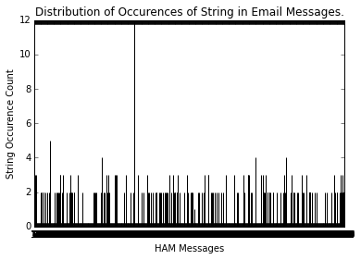
Presence/Absence of PGP Signature in Email Message Body
Spam Detection
The Outliers - Vishal Bhalla & Nithish Raghunandanan

Slide 9
Feature Engineering
  Spaminess/Haminess of Email Content [1]
    Spamminess(Word) = Number of occurrences of word in Spam emails / Total Occurrences of word in Emails
    Spamminess(Message) = Product of Spamminess(Words) in the Email
  Spaminess/Haminess of Top Spam/Ham Words
    Spaminess & Haminess of extreme K words in terms of spaminess/haminess considered.
The Outliers - Vishal Bhalla & Nithish Raghunandanan

Slide 10
Feature Engineering(2)
  Spaminess of Top K Spam Words in Emails
    Spaminess of extreme K words in terms of spaminess/haminess considered.
  Ratio of Spam words
    Ratio of Spam words to total words
The Outliers - Vishal Bhalla & Nithish Raghunandanan

Slide 11
Static Rules
  Rule 1
    SpamAssassin Classification in Email Subject.
  Rule 2
    Presence of PGP Signature in the Email Body.
  Rule 3
    Date of Email in extreme future/past.
  Rule 4
    Presence of Sender information.
  Rule 5
    Too many capitalized words in the Email Body.
The Outliers - Vishal Bhalla & Nithish Raghunandanan

Slide 12
Models
We tried different types of Binary Classification Models to fit our data
  Naive Bayes
  K Nearest Neighbors (kNN)
  Random Forests (RF)
  Adaboost
  Vowpal Wabbit (VW)
The Outliers - Vishal Bhalla & Nithish Raghunandanan

Slide 13
Naive Bayes
  Classification Criteria
    Spaminess > Haminess
    Top K Spam/Ham
    Top K Spam > Threshold
The Outliers - Vishal Bhalla & Nithish Raghunandanan

Slide 14
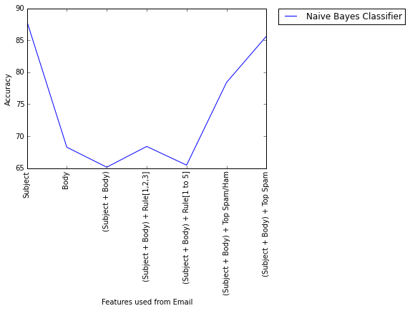
Naive Bayes(2)
  Evaluation
The Outliers - Vishal Bhalla & Nithish Raghunandanan

Slide 15
Random Forests
  Email fields used as feature vector
    Subject
    Body
    Combined (Subject and Body)
    All features (Combined + Special words, capital letter words & PGP) + Spaminess > Haminess metric
    All features + Ratio of Spam words metric
    All features + Ratio of Spam words metric + Static Rules
    All features + Top K Spam > Threshold metric
The Outliers - Vishal Bhalla & Nithish Raghunandanan

Slide 16
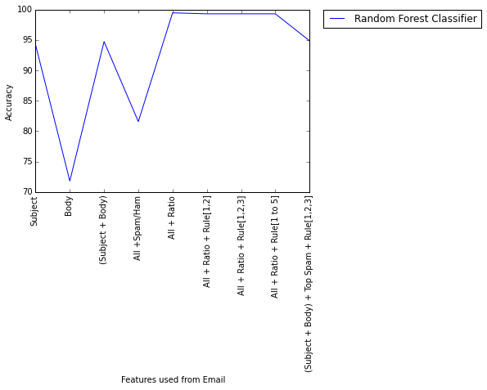
Random Forests
The Outliers - Vishal Bhalla & Nithish Raghunandanan

Slide 17
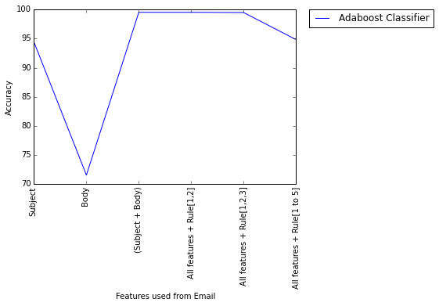
Adaboost
The Outliers - Vishal Bhalla & Nithish Raghunandanan

Slide 18
Vowpal Wabbit
  Fast, efficient library for Online Machine Learning.
  Program developed originally at Yahoo! Research, and currently at Microsoft Research [2].
  Adaptive Learning with minimization of loss.
  Features
    Email Subjects
    Email Body
    Email Subjects + Body
    Email as a string with headers
The Outliers - Vishal Bhalla & Nithish Raghunandanan

Slide 19
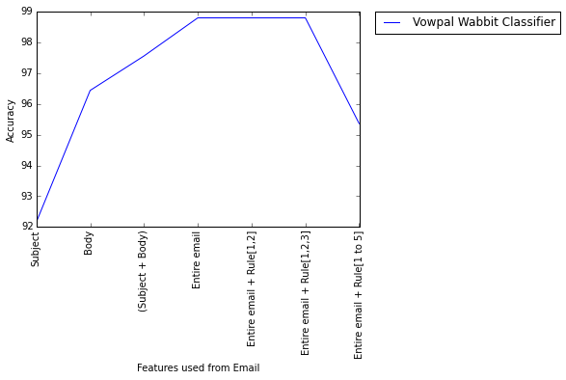
Vowpal Wabbit(2)
The Outliers - Vishal Bhalla & Nithish Raghunandanan

Slide 20
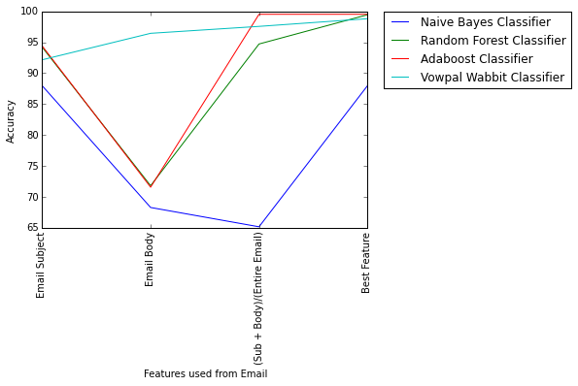
Evaluation of the Models
Criteria
Classification Accuracy on Stratified K-Fold Cross Validation with a split of 4:1.
The Outliers - Vishal Bhalla & Nithish Raghunandanan

Slide 21
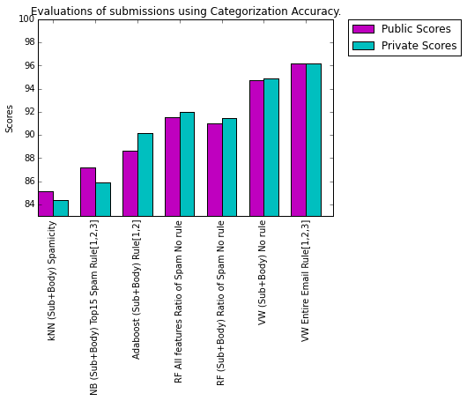
Kaggle Results
The Outliers - Vishal Bhalla & Nithish Raghunandanan

Slide 22
Conclusion
The best results were observed for the classification by Vowpal Wabbit.
Adding all information as features for the classifier helps.
Naive Bayes depends on the calculation of Spamminess/ Haminess parameters.
Not all static rules are important!
Rules 1 [SpamAssasinator], Rule 2 [PGP Signature] & Rule 3 [Date] were the most useful.
The Outliers - Vishal Bhalla & Nithish Raghunandanan

Slide 23
Key Takeaways
Vowpal Wabbit is useful in dealing with raw Strings & is extremely fast.
Better Metric for computing Spamminess or Spammicity of words.
The Outliers - Vishal Bhalla & Nithish Raghunandanan

Slide 24
References
[1] Metric for computing Spamminess or Spammicity of words
Awad, W. A., and S. M. ELseuofi. "Machine Learning methods for E-mail Classification." International Journal of Computer Applications (0975–8887) 16.1 (2011).
[2] Vowpal Wabbit
Langford, John, L. Li, and A. Strehl. "Vowpal wabbit." URL https://github. com/JohnLangford/vowpal_wabbit/wiki (2011).
The Outliers - Vishal Bhalla & Nithish Raghunandanan

Slide 25

Questions?
The Outliers - Vishal Bhalla & Nithish Raghunandanan

Slide 26
Thank You !
The Outliers - Vishal Bhalla & Nithish Raghunandanan

